Slide 1






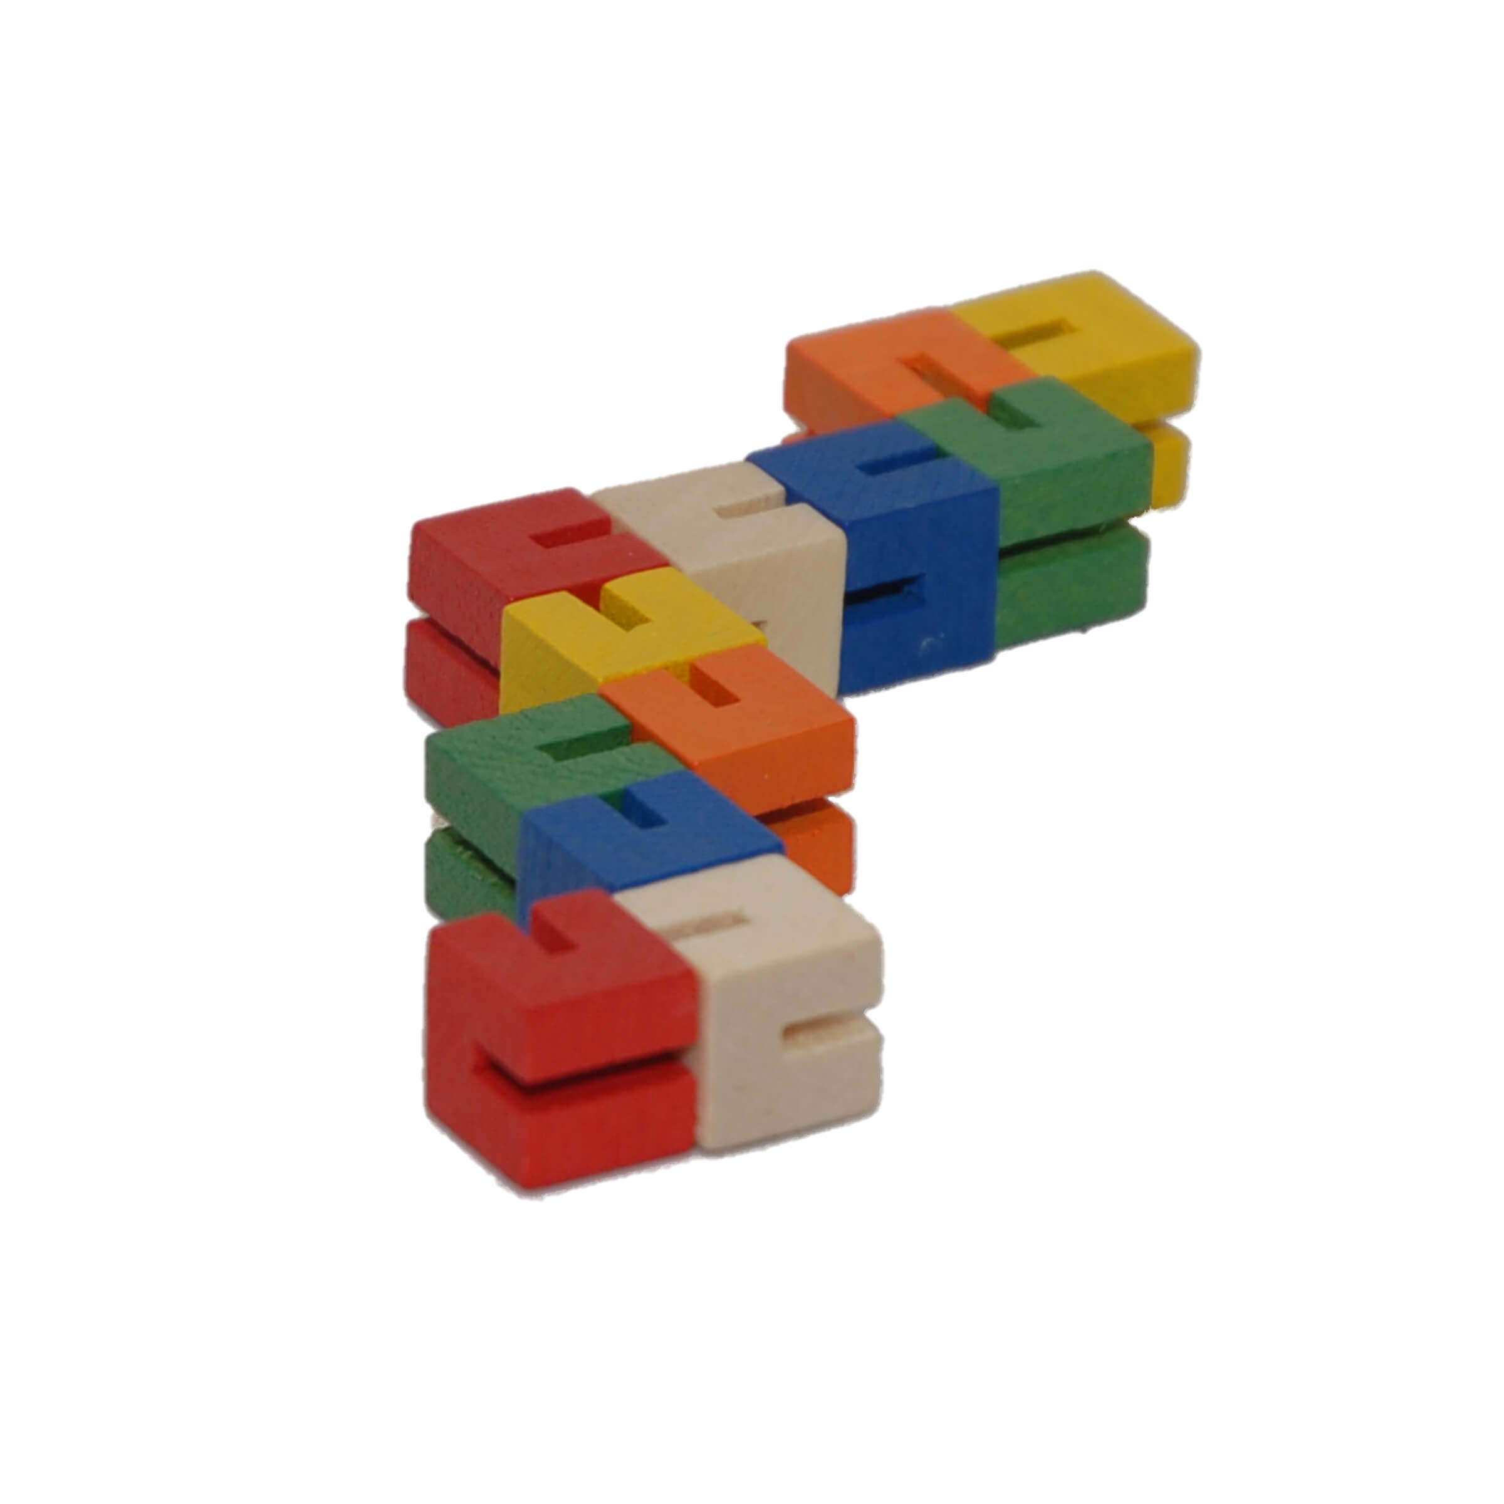

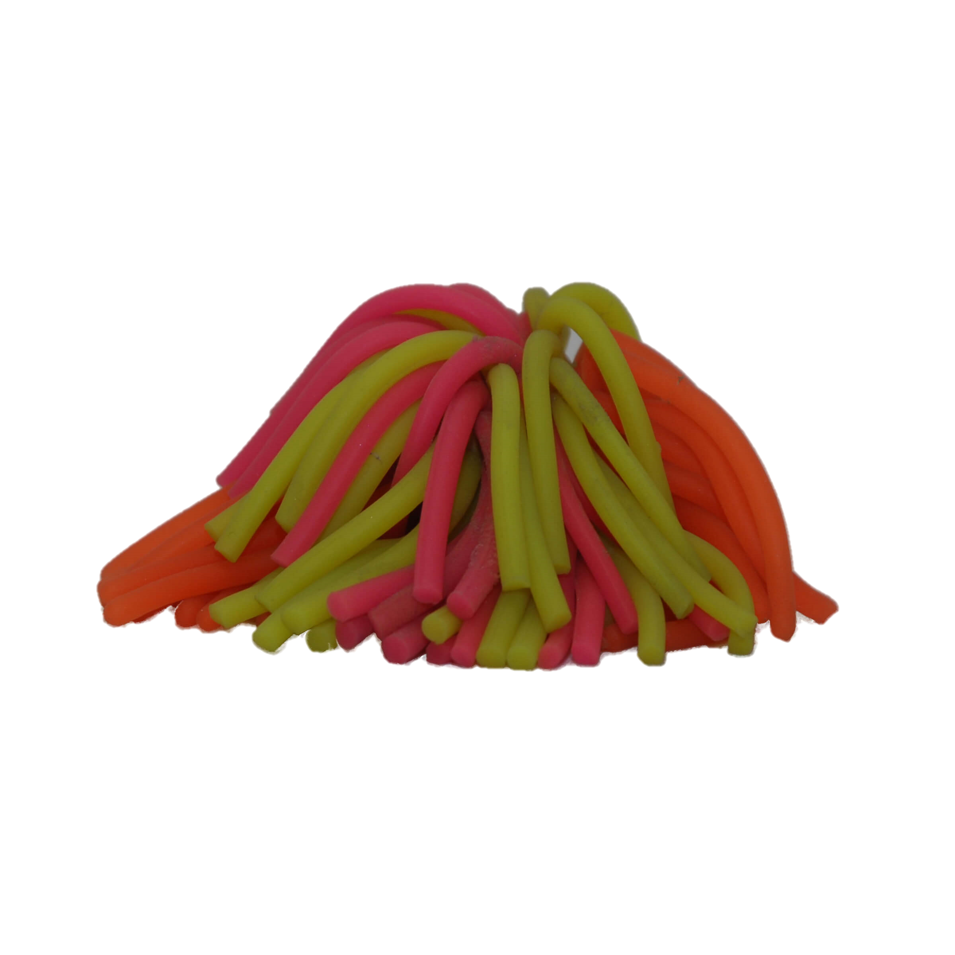
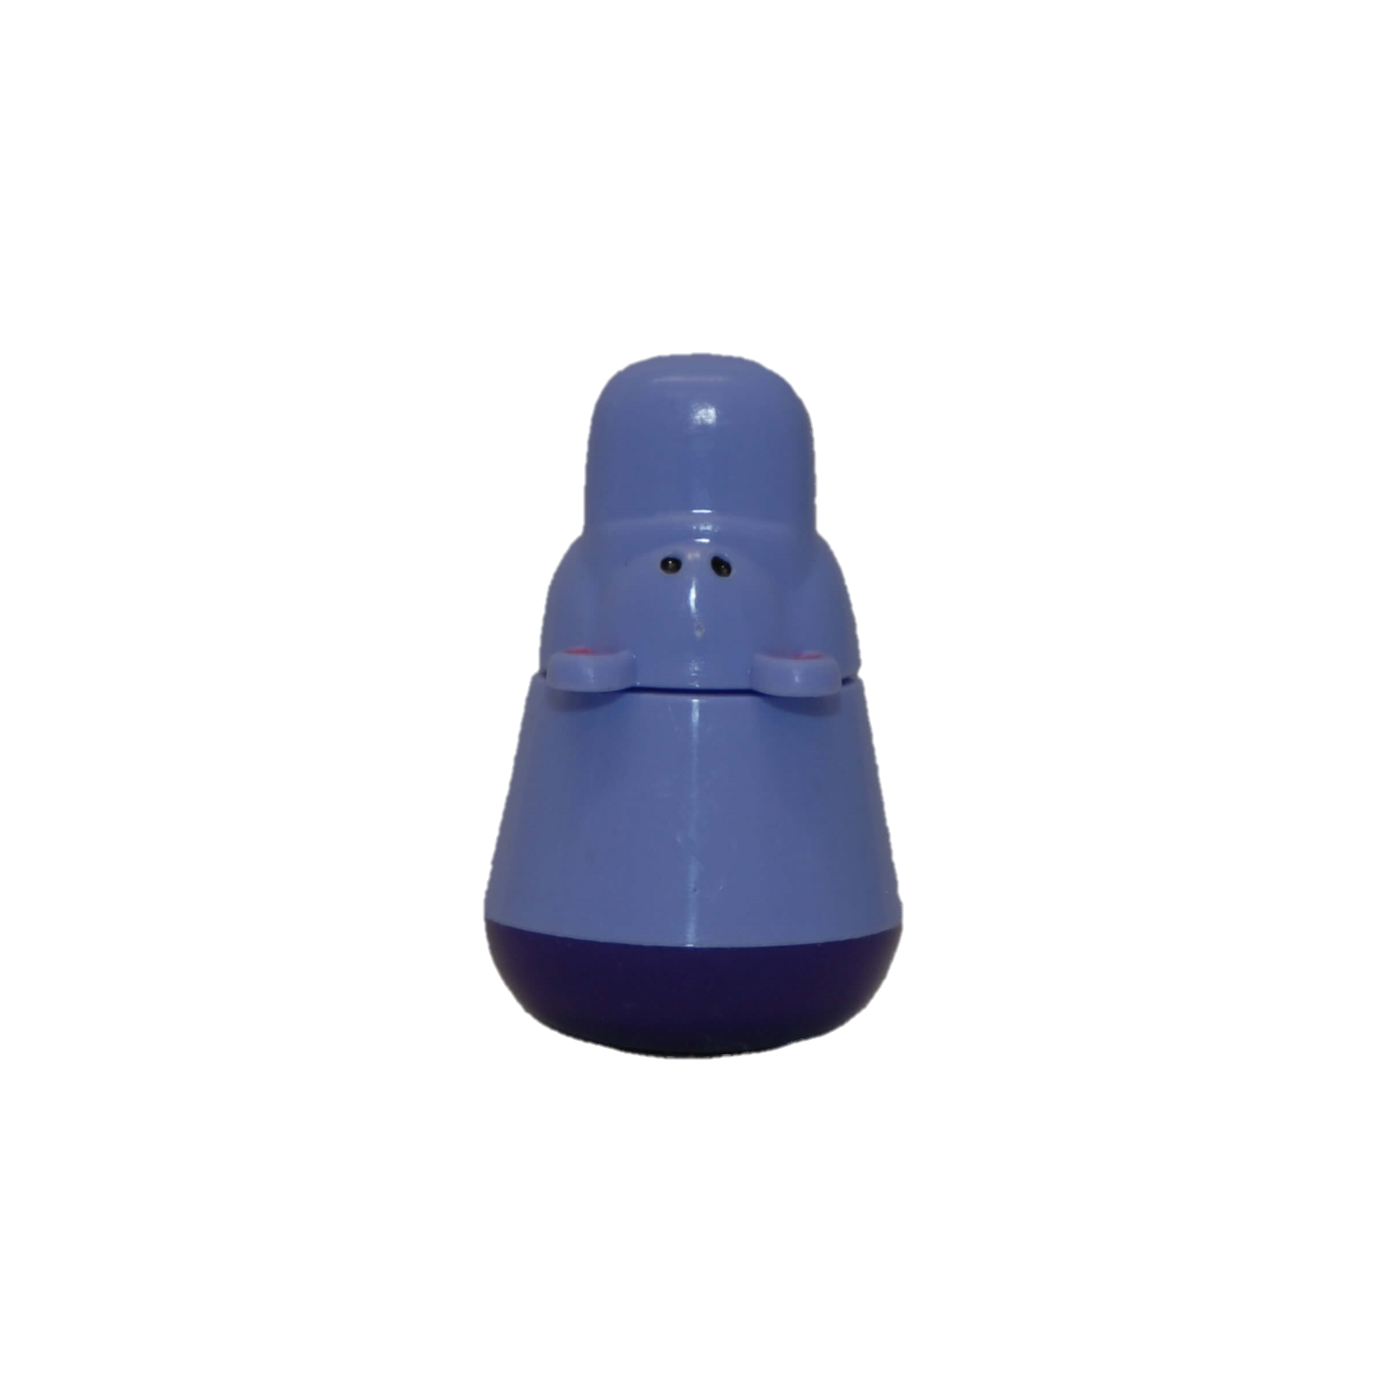
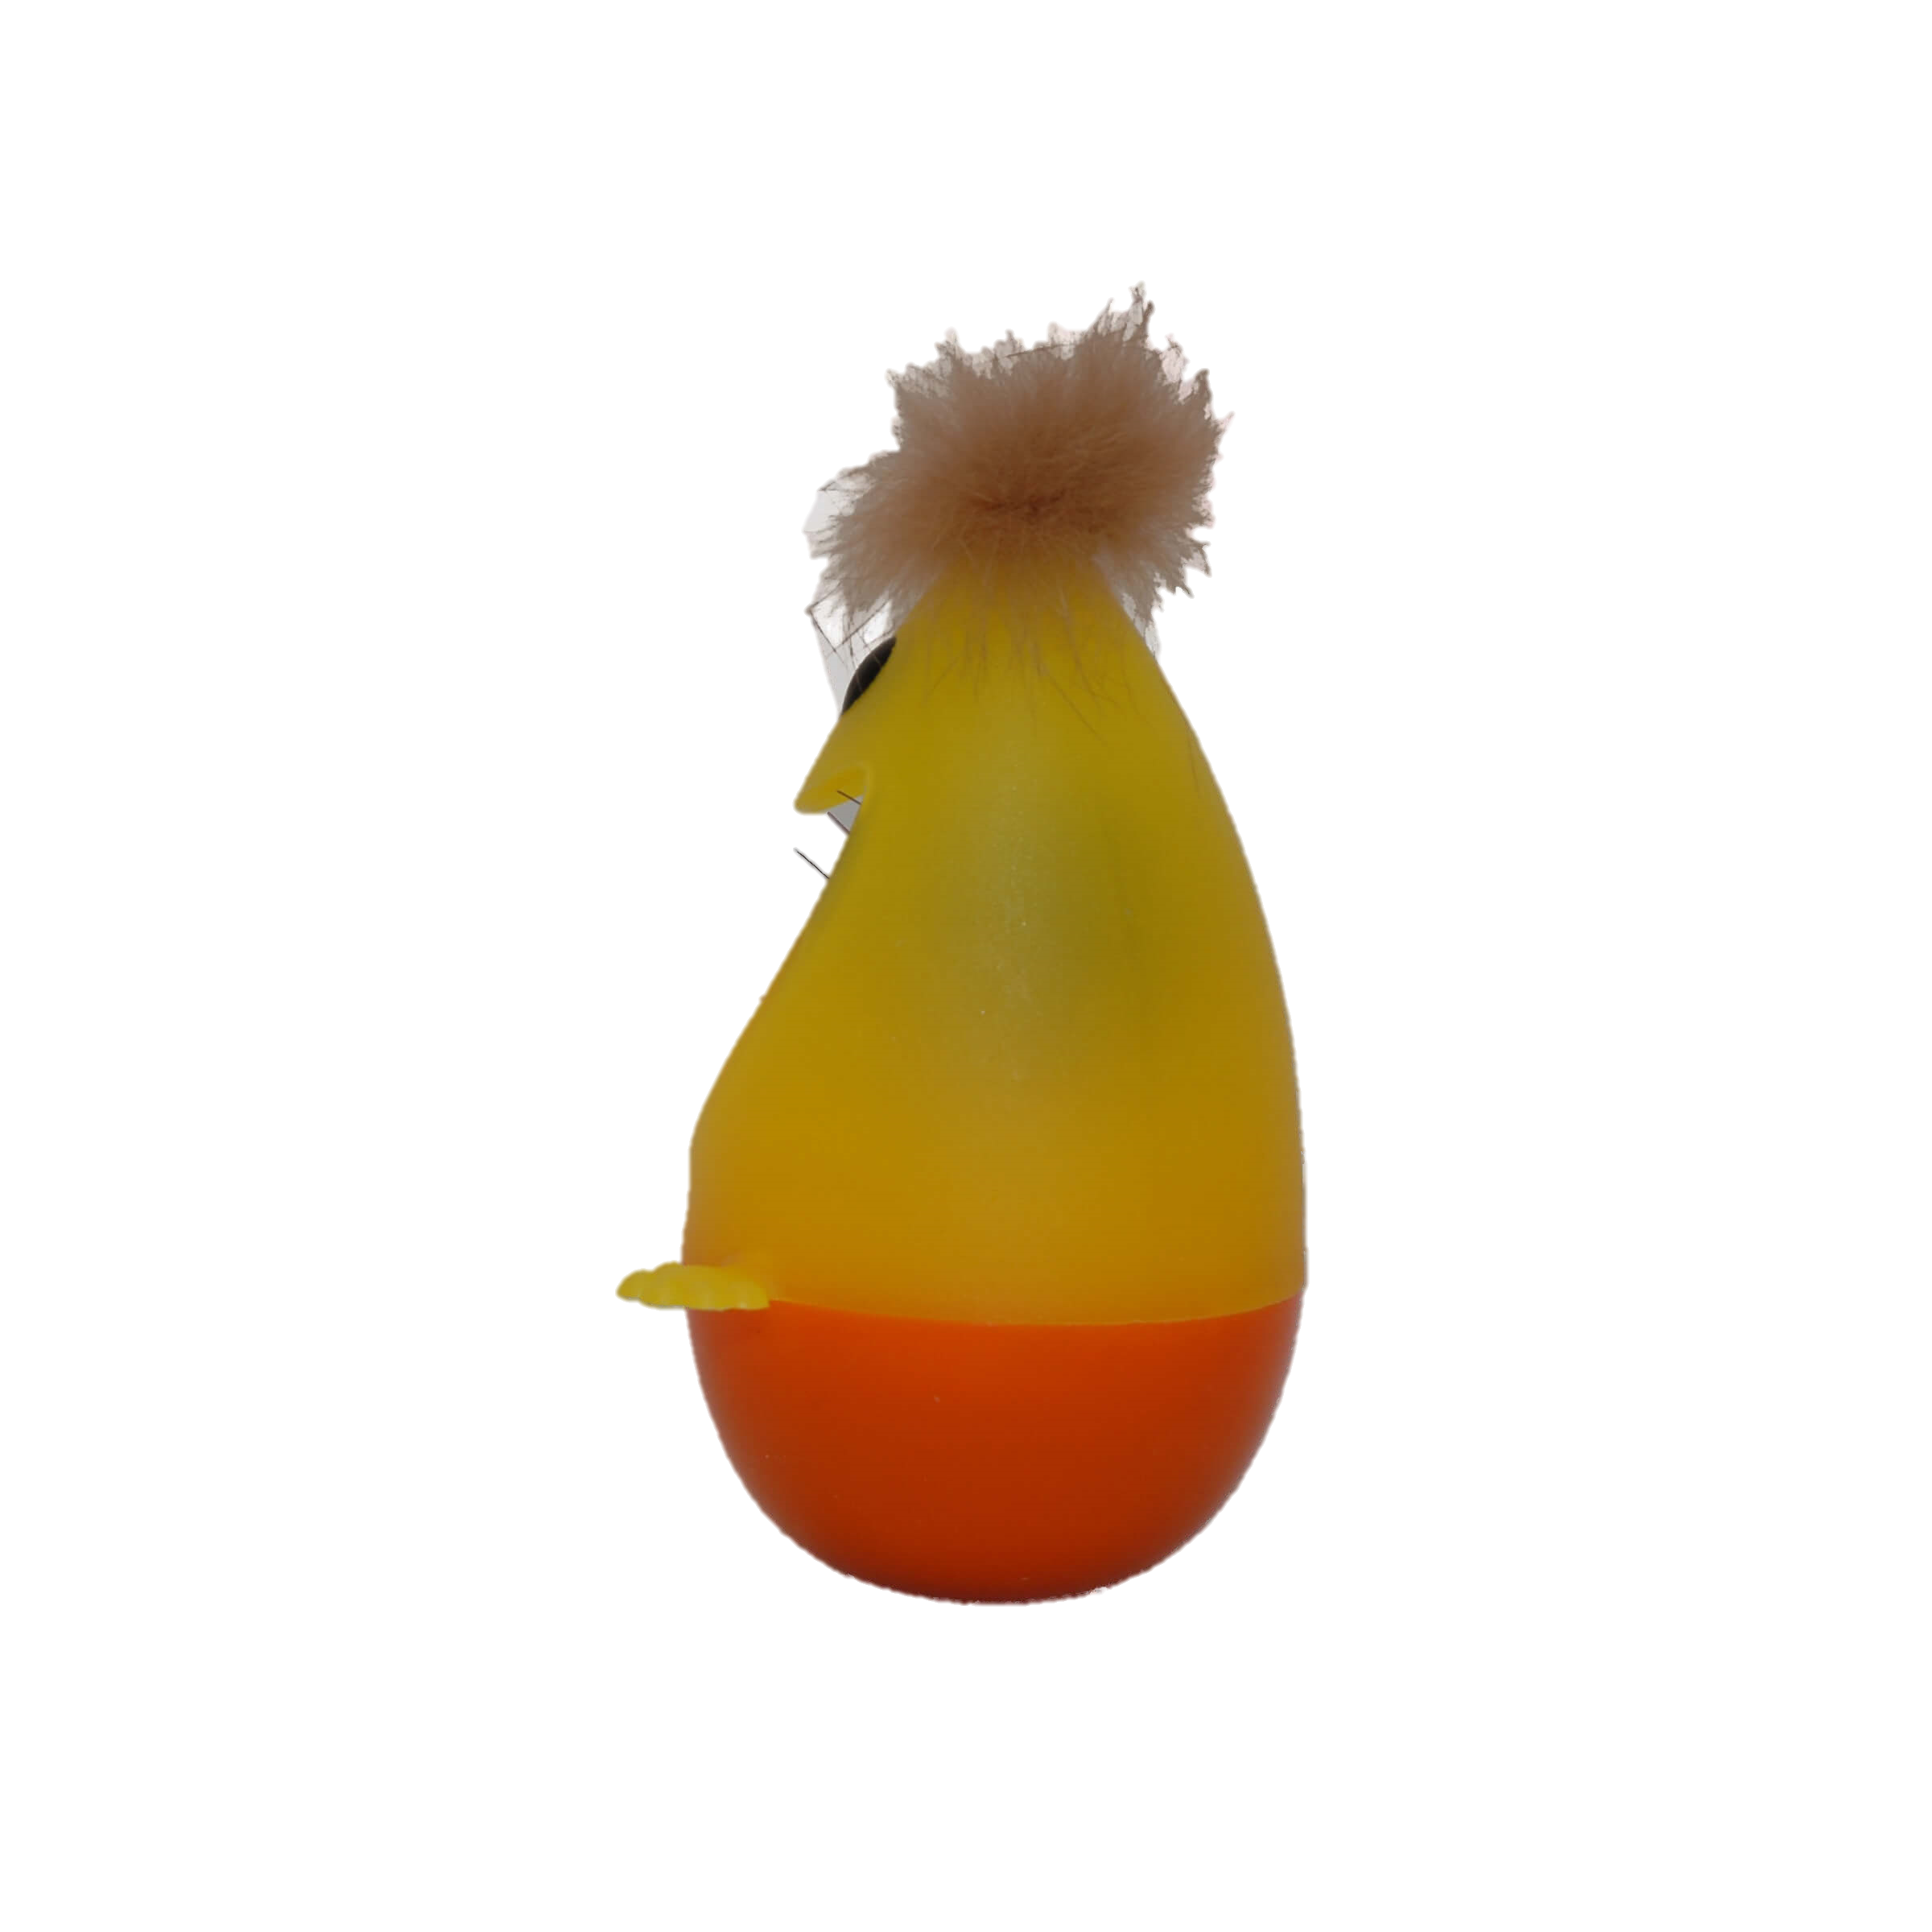

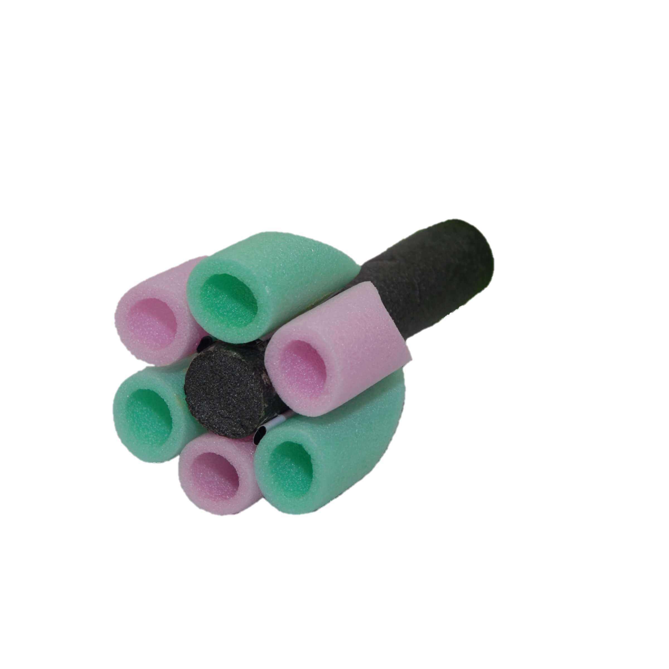
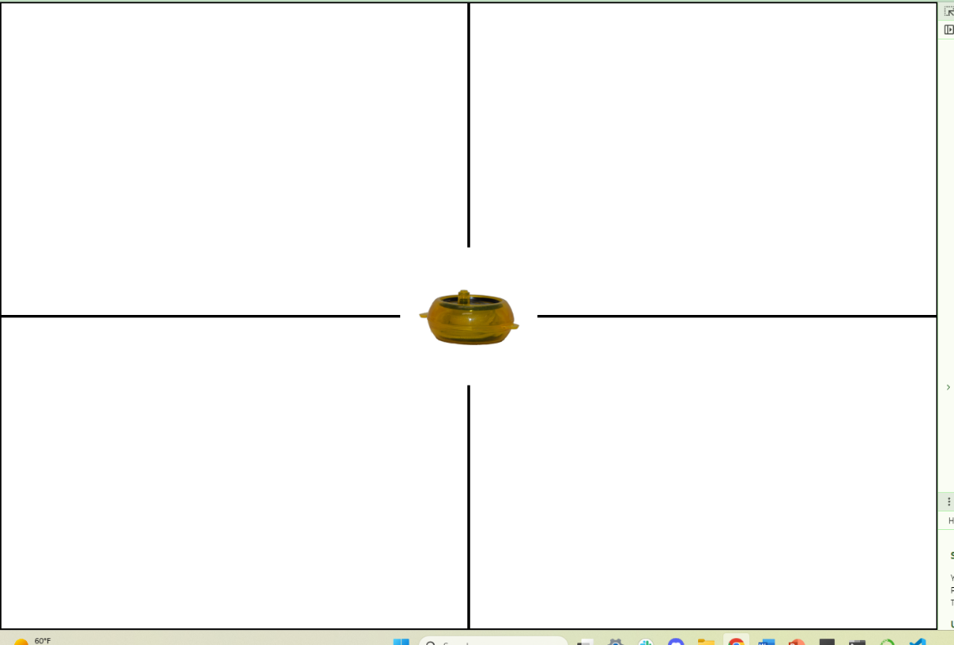

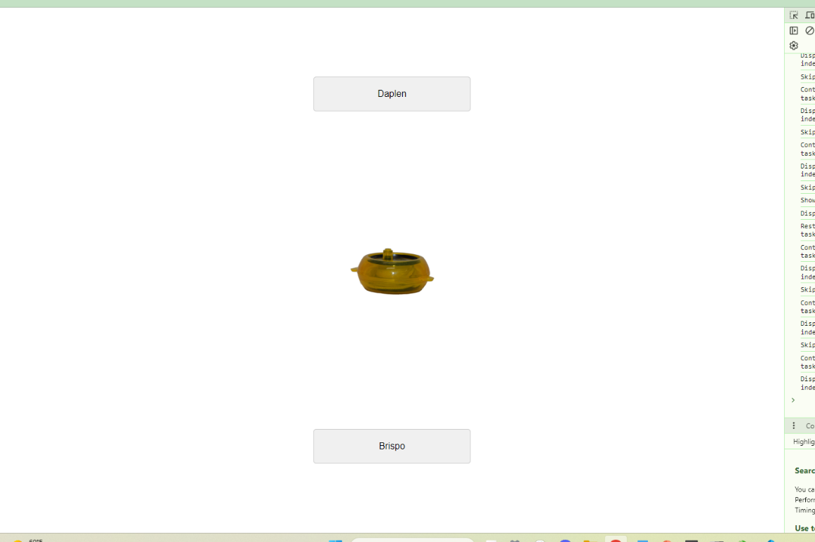
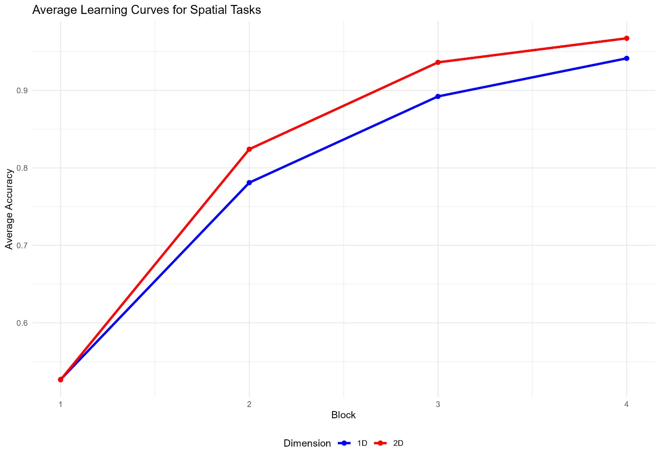
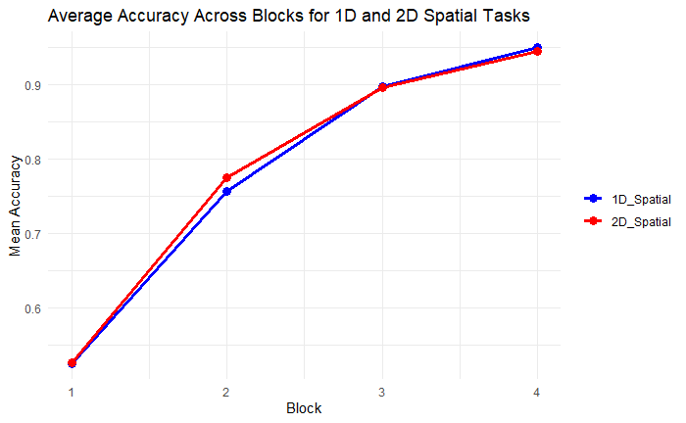
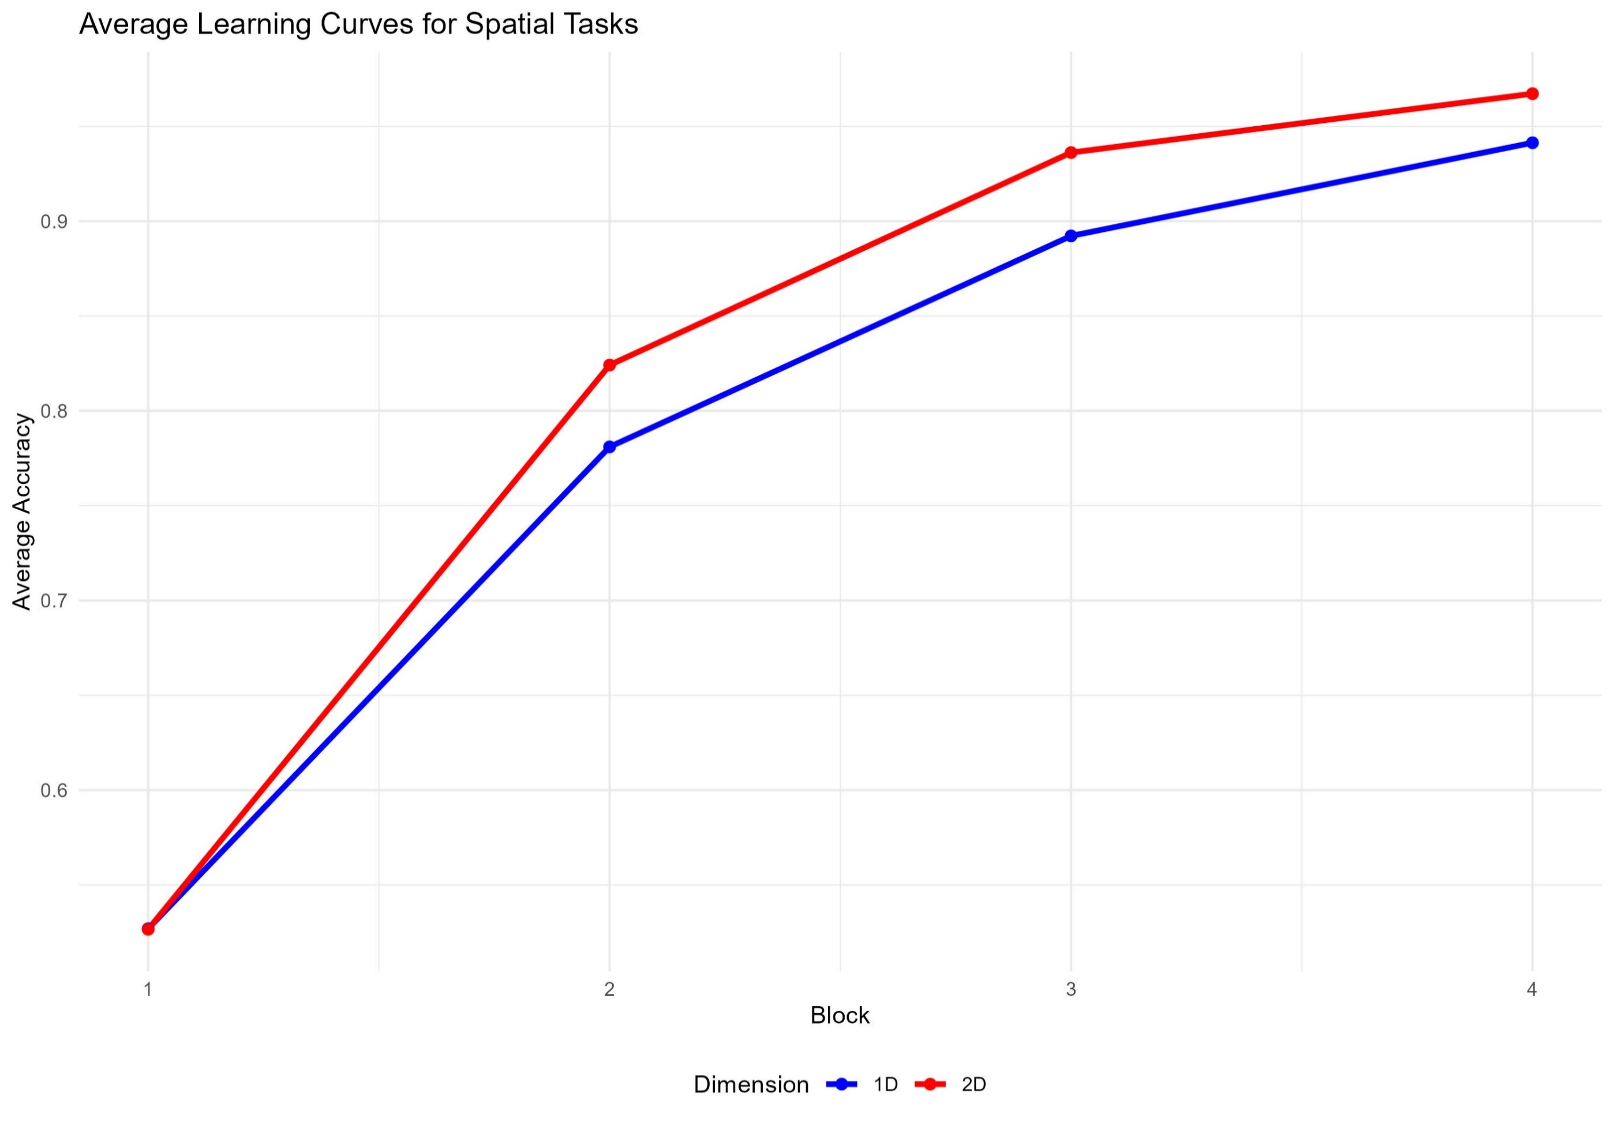
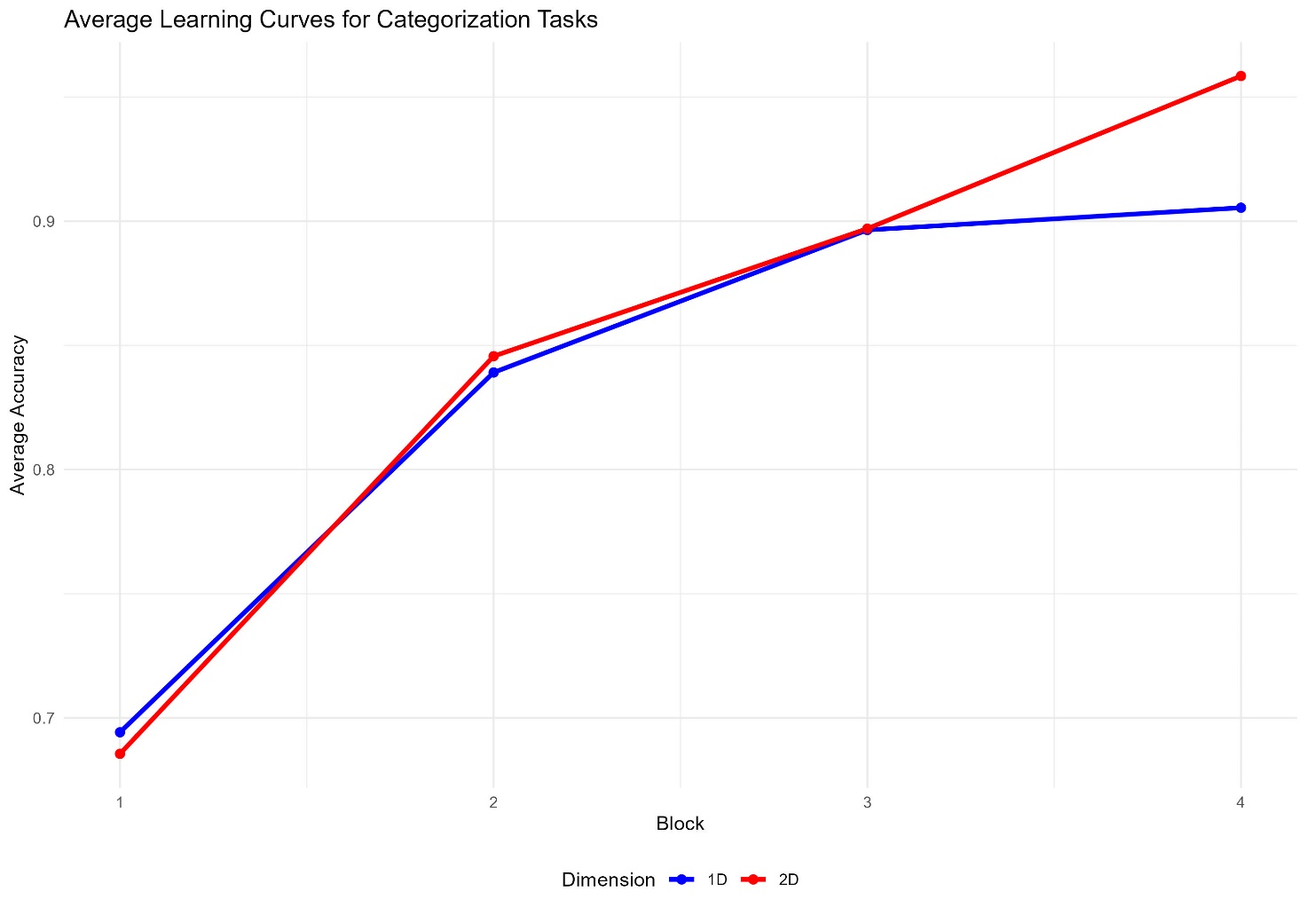
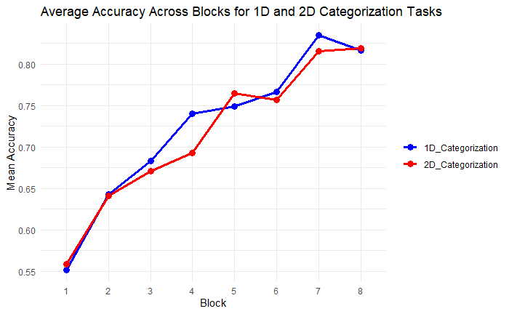
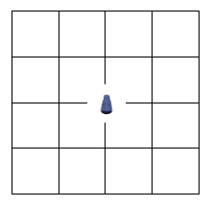
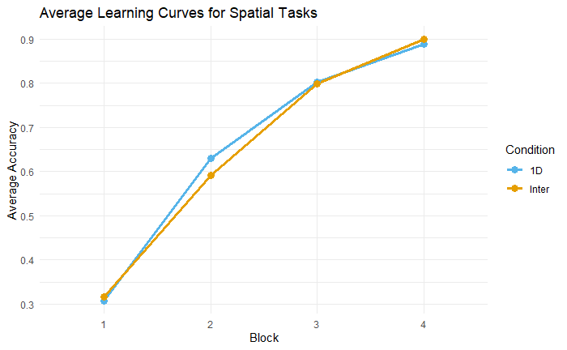
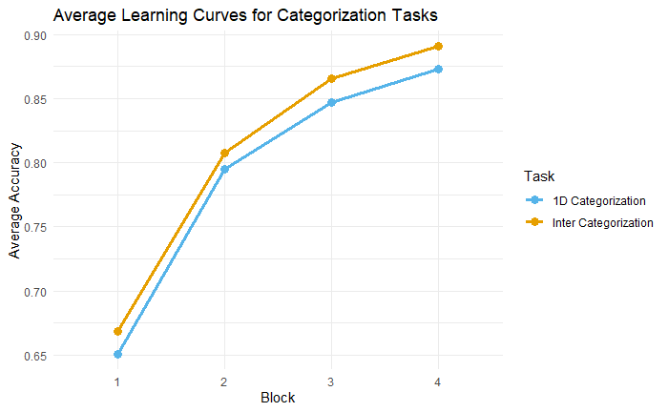
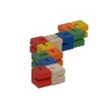

Designing a Task to Measure the Impact of Spatial Layouts on Categorization Learning
Michelle B. Hefner^{1,2}, Maria Ruz^{1,2}, Christopher Summerfield³
¹Mind, Brain and Behavior Research Center (CIMCYC), University of Granada, Spain
²Department of Experimental Psychology, University of Granada, Spain
³Department of Experimental Psychology, University of Oxford, UK
Introduction
Paradigm
Spatial reference frames help structure both spatial and nonspatial knowledge [1,2].
Humans naturally use familiar spatial structures such as rows, grids, and axes to process both spatial and nonspatial information [3].
Computational mechanisms explaining how space aligns information for cognitive processing remain unclear.
Aim: To design an experimental task that measures the connection between spatial layouts, memory, and categorization learning.
H1: Spatial memory influences categorization performance.
H2: Participants will perform better when categorization aligns with a clear spatial structure, compared to more complex spatial arrangements.
Stimuli examples:
Experiment Design 1:
Experimental Design 2:
Metrics (both designs): Accuracy, Response time (RT)
Aims & Hypotheses
Object-location association (Spatial)
Spatial Layouts (counterbalanced):
Categories:
brispo
daplen
1D
Categorization
Results
2D
Design 1:
First approach task sequence
Second approach task sequence
First approach task sequence:
1D spatial
1D categorization
2D spatial
2D categorization
train
test
train
test
Second approach task sequence:
1D spatial
2D spatial
Mixed categorization
train
train
test
Object-location association (Spatial)
Spatial Layouts (counterbalanced):
Design 2:
1D
Categorization
Interdigitation (‘Inter’)
Categories:
brispo
daplen
Discussion
We observe that participants learn across blocks in both the object-location association (spatial) and categorization tasks
We have yet to see the inter-task effect of clear spatial patterns (1D) aiding in categorization performance vs more complex layouts (2D, Interdigitation)
Next steps:
Improve Task Design
Computational Modeling: Neural network models will be used to simulate learning processes
Initial approach task sequence:
1D spatial
Inter spatial
1D categorization
Inter categorization
train
train
test
test
References
Contact: mhefner@ugr.es
Scan the QR code to access the online version of this poster, as well as other ways to connect with me
[1] Gärdenfors, P. (2000). Conceptual spaces: The geometry of thought. MIT Press.
[2] Gattis, M. (Ed.). (2001). Spatial schemas and abstract thought. MIT Press.
[3] Shah, P. (Ed.). (2005). The Cambridge handbook of visuospatial thinking (1. publ). Cambridge University Press.

